Slide 1
Asexual Reproduction

Slide 2
Order of the day!
Asexual Reproduction
Mitosis Quiz!
Presentation on cancer
Individual work time
Microscope booklet?

Slide 3
What is Asexual Reproduction?
Asexual reproduction: Only one parent is required, and the offspring is a genetic copy to the parent, or a clone.
Can use Mitosis!

Slide 4
Types of Asexual Reproduction
Binary fission:
One-celled prokaryotic organisms reproduce by replicating its genetic material and dividing into two. They have no organized nucleus, so this is simpler than mitosis.
** Mutations can still occur

Slide 5
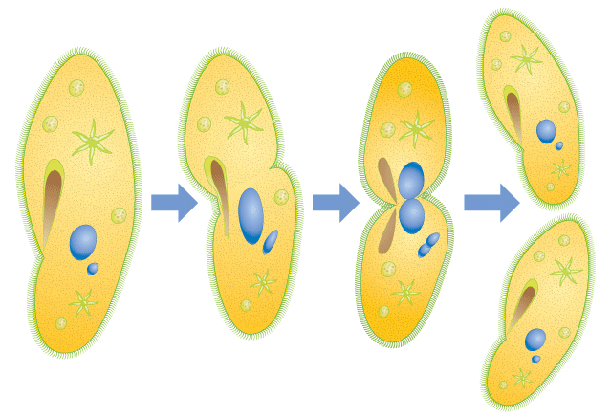

Slide 6
Video on binary fission:
http://www.youtube.com/watch?v=DY9DNWcqxI4

Slide 7
Budding
The organism develops an outgrowth or bud, which detaches from parents and becomes a new individual. This is common in some multicellular organisms, such as sponges and hydras, and some single-celled organisms such as yeast.

Slide 8
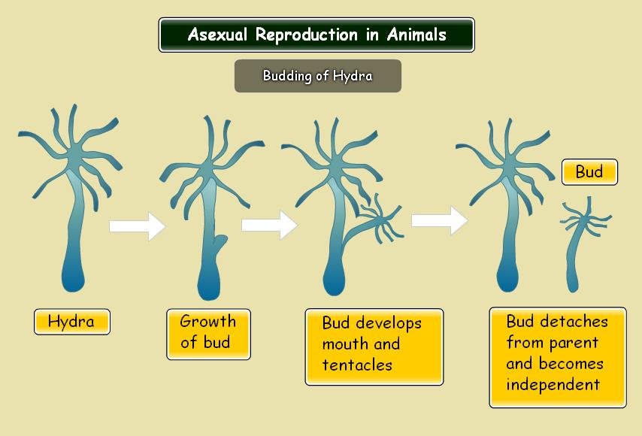

Slide 9
Video on budding:
http://www.youtube.com/watch?v=hXaswpUjK-M

Slide 10
Fragmentation
If an organism breaks apart as a result of injury, the new fragment develops as a clone of its parent, and the injury is healed on the parent as well. This happens to some animals and plants.

Slide 11
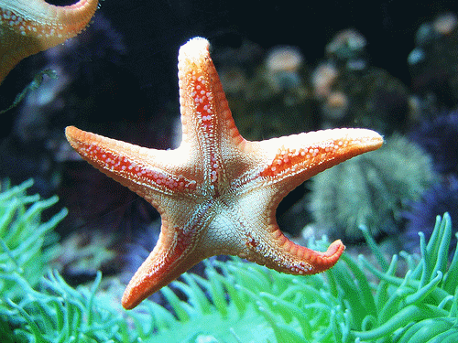

Slide 12
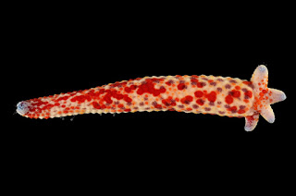
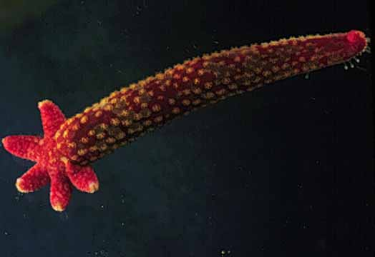

Slide 13
So far, we have seen:
1.
2.
3.

Slide 14
Vegetative Reproduction
In this type of division, special cells divide repeatedly to form structures that will eventually develop into a plant identical to the parent. Examples: Tulips, daffodils, and potatoes.

Slide 15
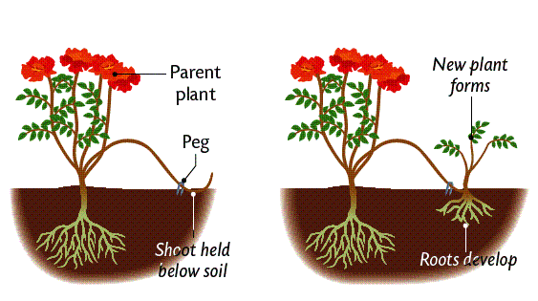

Slide 16
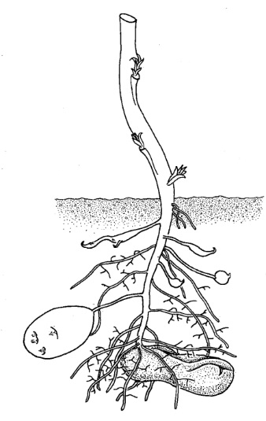
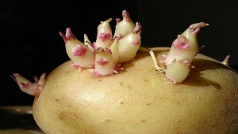

Slide 17
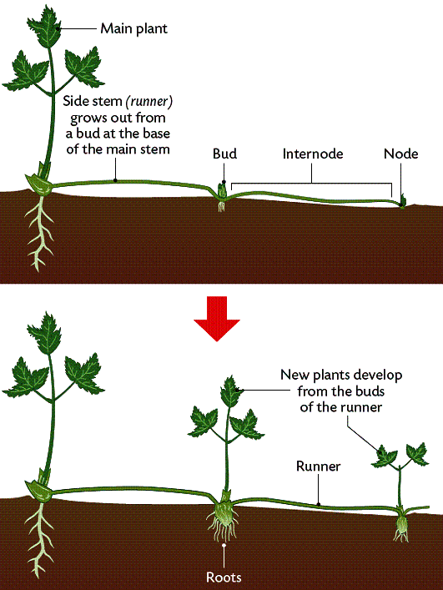

Slide 18
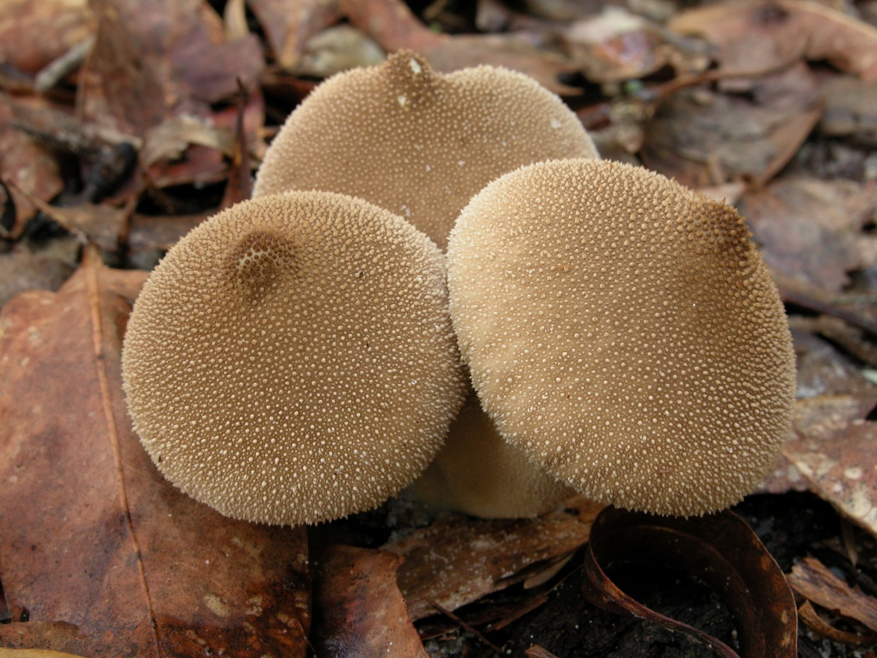
Spore Formation
Some organisms form single-celled spores in order to reproduce; these spores are carried out by water or wind, hoping to find a suitable location in order to grow.
Examples of organisms that use spores are some fungi, such as mould and puffballs, and some bacteria.

Slide 19
Video on spores:
http://www.youtube.com/watch?v=kWSYawl0KjQ

Slide 20
Tomorrow, we will see:
Human- Assisted Cloning
Friday: CHAPTER 5 TEST

